Slide 1
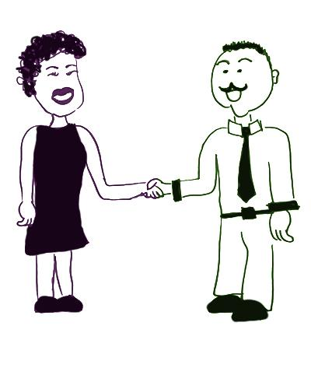
Effective Conclusion
An effective conclusion
It was great to meet you, Jose. I hope I convinced you that gadgets are the next big thing! Gadgets are making everyday tasks much simpler. The best gadgets are easy to use without any special training. They’re fun to use and make even boring tasks more enjoyable. You should go out and buy a gadget today!
Bye. Thanks for talking with me
Marcia’s conclusion
restates the points she made earlier.
ends with a final thought.

